Slide 1

The Truth

Slide 2
Questions/Answers on the Truth
What?
Why?
How?
Where?
When?
Who?

Slide 3
Questions/Answers on the Truth
What?
Why?
How?
Where?
When?
Who?

Slide 4
John 18:37-38 Pilate therefore said unto him, Art thou a king then? Jesus answered, Thou sayest that I am a king. To this end was I born, and for this cause came I into the world, that I should bear witness unto the truth. Every one that is of the truth heareth my voice. 38 Pilate saith unto him, What is truth? And when he had said this, he went out again unto the Jews, and saith unto them, I find in him no fault at all.
  Pilate says, I don’t even know what truth is. How do I know it when I see it? Where can I find it?
  The truth seems to be elusive, or subject to one’s point of view.
Job 28:12 But where shall wisdom be found? and where is the place of understanding?

Slide 5


Slide 6
Acts 17:19-21 And they took him, and brought him unto Areopagus, saying, May we know what this new doctrine, whereof thou speakest, is? 20 For thou bringest certain strange things to our ears: we would know therefore what these things mean. 21 (For all the Athenians and strangers which were there spent their time in nothing else, but either to tell, or to hear some new thing.)
  Many dedicate all their time to learning. Trying to find truth and wisdom.
  CLIP – YOU CAN’T HANDLE THE TRUTH
  We want the truth!! But when we find it, we often don’t.
Acts 24:25 And as he reasoned of righteousness, temperance, and judgment to come, Felix trembled, and answered, Go thy way for this time; when I have a convenient season, I will call for thee.
  When we are given the truth we often tell it to go away.
  We may outright reject it, or tell ourselves that its just not a good time and we’ll look for it again later.

Slide 7


Slide 8
Jeremiah 5:1 Run ye to and fro through the streets of Jerusalem, and see now, and know, and seek in the broad places thereof, if ye can find a man, if there be any that executeth judgment, that seeketh the truth; and I will pardon it.
  Just like with Sodom and Gomorrah, God looks for those that seek the truth.
  How many does he find? How many plead for the truth?
Isaiah 59:4 None calleth for justice, nor any pleadeth for truth: they trust in vanity, and speak lies; they conceive mischief, and bring forth iniquity.
  Man just doesn’t want the truth. Instead…

Slide 9
Jeremiah 9:3 And they bend their tongues like their bow for lies: but they are not valiant for the truth upon the earth; for they proceed from evil to evil, and they know not me, saith the LORD.
  How easy is it to bend a bow?
  The world stresses to craft lies. They take great effort to carefully go from lie to lie.
  God wants you to be valiant for the truth.
  We should be striving to be prepared with the truth and able to deliver it.
1 Timothy 2:4 Who will have all men to be saved, and to come unto the knowledge of the truth.
  But the world doesn’t want it, so why should you?

Slide 10
Questions/Answers on the Truth
What?
Why?
How?
Where?
When?
Who?

Slide 11
Proverbs 3:13-15 Happy is the man that findeth wisdom, and the man that getteth understanding. 14 For the merchandise of it is better than the merchandise of silver, and the gain thereof than fine gold. 15 She is more precious than rubies: and all the things thou canst desire are not to be compared unto her.
  The truth is valuable.
  Everything you desire or could desire doesn’t compare to the value of the truth.

Slide 12
Job 28:12-19 But where shall wisdom be found? and where is the place of understanding? 13 Man knoweth not the price thereof; neither is it found in the land of the living. 14 The depth saith, It is not in me: and the sea saith, It is not with me. 15 It cannot be gotten for gold, neither shall silver be weighed for the price thereof. 16 It cannot be valued with the gold of Ophir, with the precious onyx, or the sapphire. 17 The gold and the crystal cannot equal it: and the exchange of it shall not be for jewels of fine gold. 18 No mention shall be made of coral, or of pearls: for the price of wisdom is above rubies. 19 The topaz of Ethiopia shall not equal it, neither shall it be valued with pure gold.
  Wisdom, understanding, and truth are valuable. More valuable than any amount of dollars, gold, silver, rubies, crystals, sapphire, pearls.
  Not only is it valuable, but it is incredibly hard to find.
  What would you call that?

Slide 13
Proverbs 2:3-4 Yea, if thou criest after knowledge, and liftest up thy voice for understanding; 4 If thou seekest her as silver, and searchest for her as for hid treasures;
  Truth is rarer and more valuable than treasure.
Colossians 2:3 In whom are hid all the treasures of wisdom and knowledge.
Proverbs 10:14 Wise men lay up knowledge: but the mouth of the foolish is near destruction.
  Save it, collect it, preserve it.
  Why else should you care?

Slide 14
John 8:32 And ye shall know the truth, and the truth shall make you free.
  The truth is better than a get out of jail free card.
  Jesus makes you free, you are free indeed.
  The truth has tremendous power and value.
1 Peter 2:2 As newborn babes, desire the sincere milk of the word, that ye may grow thereby:
  The truth is your life source, your nutrition.
  Without the truth, you have no life in you. Without the truth, you don’t grow.
  The truth is life and energy. I’d say that is tremendous value.

Slide 15
Psalms 145:18 The LORD is nigh unto all them that call upon him, to all that call upon him in truth.
  The truth is necessary for you to serve God, to even have a relationship with or approach to Him.
  You need to find the truth, get in it, and then you can call on him.
  You cannot be near to God when you are in a lie.
  You will not be able to call on him if you aren’t in the truth.
  Even a Christian can go unheard if they follow lies.
  If you tune him out and want none of his truth, he’ll leave you alone.
John 4:24 God is a Spirit: and they that worship him must worship him in spirit and in truth.
  Just like you have to be in the Spirit, you also have to be in the truth.
  You need the truth, to be in the truth, in order to serve God.
  If you don’t follow the truth, wherever it tells you to go, you can’t serve God.
  You can’t pick and choose what parts of the Bible you want to believe.
  What does it mean to serve him in truth? It also means honestly, and not for self.

Slide 16
John 3:33 He that hath received his testimony hath set to his seal that God is true.
  When you receive the truth it is stamping you with “God is true, not me”. That says a great deal to God.
Ephesians 6:14 Stand therefore, having your loins girt about with truth, and having on the breastplate of righteousness;
  Why the truth about your loins? Because it protects from you being ashamed.
  It is the absolute foundation of your armor. If you don’t have your underpants on, you shouldn’t be going to war.
  You will be ashamed and exposed.
  The world thinks it is smart regarding the truth.

Slide 17



Slide 18
John 8:32 And ye shall know the truth, and the truth shall make you free.
  Is there anything of more value to a man than freedom?

Slide 19

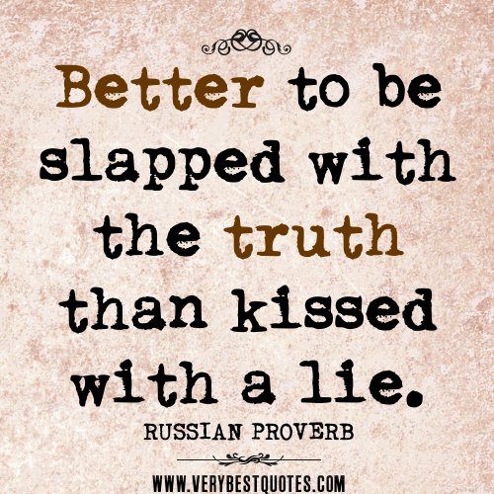

Slide 20
Proverbs 27:5-6 Open rebuke is better than secret love. 6 Faithful are the wounds of a friend; but the kisses of an enemy are deceitful.
  “It is better to be slapped with the truth, than kissed with a lie.”
  You should want to be rebuked with the truth over having hidden, passionate love.
  You should want wounds of truth over kisses.
  Is that not valuable?
Proverbs 9:8 Reprove not a scorner, lest he hate thee: rebuke a wise man, and he will love thee.
  The wise man will love you for giving him the truth. But the unwise will hate you.
Proverbs 28:23 He that rebuketh a man afterwards shall find more favour than he that flattereth with the tongue.
  You want true friendships?
  (1) Tell the truth and (2) desire the truth.

Slide 21
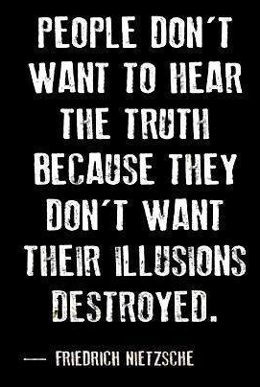
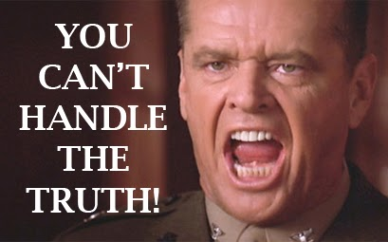
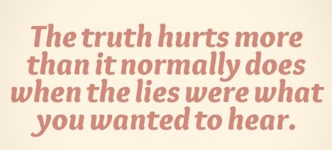

Slide 22
Proverbs 15:10 Correction is grievous unto him that forsaketh the way: and he that hateth reproof shall die.
  Will you die if you reject God’s reproof?
  The truth hurts us, because we are in the lie. Because our deeds are evil!
John 3:19-21 And this is the condemnation, that light is come into the world, and men loved darkness rather than light, because their deeds were evil. 20 For every one that doeth evil hateth the light, neither cometh to the light, lest his deeds should be reproved. 21 But he that doeth truth cometh to the light, that his deeds may be made manifest, that they are wrought in God.
  The truth is like light. The truth makes manifest who and what you are.
  We react poorly to the truth because who and what we are is evil.
  The world claims to want truth. But when it comes we often reject it.
  How can you correct yourself if you don’t look in the mirror?
  The truth almost always hurts because we are evil. And we are almost always in a lie.

Slide 23
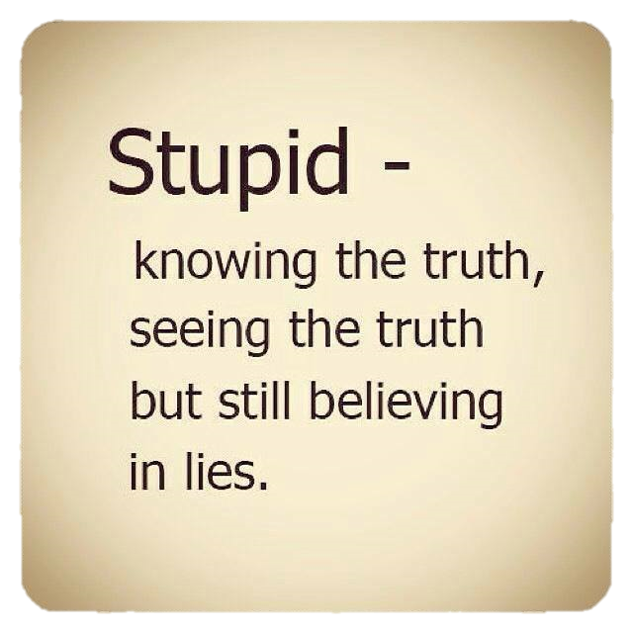

Slide 24
Proverbs 15:32 He that refuseth instruction despiseth his own soul: but he that heareth reproof getteth understanding.
  When you turn your ears from the truth, you despise your own soul.
  What does that make you?
Proverbs 15:5 A fool despiseth his father's instruction: but he that regardeth reproof is prudent.
  Stupid. Foolish.
  When you reject the truth, when you do not want instruction and reproof.
  When you outright reject what you hear from the pulpit without basing it on scripture?
  What does it result in?
Proverbs 13:18 Poverty and shame shall be to him that refuseth instruction: but he that regardeth reproof shall be honoured.
  Poverty and shame SHALL be to the fool.
  When you don’t accept the world’s wisdom and truth, you will be poor and ashamed.
    Psycho Dad.
  When you don’t accept God’s wisdom and truth….

Slide 25
1 Kings 22:12-17 And all the prophets prophesied so, saying, Go up to Ramothgilead, and prosper: for the LORD shall deliver it into the king's hand. 13 And the messenger that was gone to call Micaiah spake unto him, saying, Behold now, the words of the prophets declare good unto the king with one mouth: let thy word, I pray thee, be like the word of one of them, and speak that which is good. 14 And Micaiah said, As the LORD liveth, what the LORD saith unto me, that will I speak. 15 So he came to the king. And the king said unto him, Micaiah, shall we go against Ramothgilead to battle, or shall we forbear? And he answered him, Go, and prosper: for the LORD shall deliver it into the hand of the king. 16 And the king said unto him, How many times shall I adjure thee that thou tell me nothing but that which is true in the name of the LORD? 17 And he said, I saw all Israel scattered upon the hills, as sheep that have not a shepherd: and the LORD said, These have no master: let them return every man to his house in peace.

Slide 26
1 Kings 22:23 Now therefore, behold, the LORD hath put a lying spirit in the mouth of all these thy prophets, and the LORD hath spoken evil concerning thee.
1 Kings 22:26-27 And the king of Israel said, Take Micaiah, and carry him back unto Amon the governor of the city, and to Joash the king's son; 27 And say, Thus saith the king, Put this fellow in the prison, and feed him with bread of affliction and with water of affliction, until I come in peace.
  We men say, I want the truth!!! Tell me the truth!
  But when we get the truth? We reject it and attack the messenger.

Slide 27
Luke 22:66-67 And as soon as it was day, the elders of the people and the chief priests and the scribes came together, and led him into their council, saying, 67 Art thou the Christ? tell us. And he said unto them, If I tell you, ye will not believe:
John 8:45-46 And because I tell you the truth, ye believe me not. 46 Which of you convinceth me of sin? And if I say the truth, why do ye not believe me?
  Why would a man reject the truth when his creator tells him it face to face?
Proverbs 15:10 Correction is grievous unto him that forsaketh the way: and he that hateth reproof shall die.
  The truth hurts US.
  If it hurts us, how can we attain it?
  How do you get something that is rare and very valuable?

Slide 28
Questions/Answers on the Truth
What?
Why?
How?
Where?
When?
Who?

Slide 29
Proverbs 23:23 Buy the truth, and sell it not; also wisdom, and instruction, and understanding.
  Why does the truth hurt us? (More than it just shows us who we are.)
  The truth costs you something valuable.
  What should we do in the face of truth? (More than just believe it.)
  Not just accept or reject, believe or not believe. Buy it, or sell it.
    We’ll also be looking at wisdom, instruction, and understanding.
  How do you buy the truth?

Slide 30
Buying the Truth
Matthew 19:16-22 And, behold, one came and said unto him, Good Master, what good thing shall I do, that I may have eternal life? 17 And he said unto him, Why callest thou me good? there is none good but one, that is, God: but if thou wilt enter into life, keep the commandments. 18 He saith unto him, Which? Jesus said, Thou shalt do no murder, Thou shalt not commit adultery, Thou shalt not steal, Thou shalt not bear false witness, 19 Honour thy father and thy mother: and, Thou shalt love thy neighbour as thyself. 20 The young man saith unto him, All these things have I kept from my youth up: what lack I yet? 21 Jesus said unto him, If thou wilt be perfect, go and sell that thou hast, and give to the poor, and thou shalt have treasure in heaven: and come and follow me. 22 But when the young man heard that saying, he went away sorrowful: for he had great possessions.
  If you want the truth, you are going to have to sell what you have to pay for it.

Slide 31
Luke 12:33 Sell that ye have, and give alms; provide yourselves bags which wax not old, a treasure in the heavens that faileth not, where no thief approacheth, neither moth corrupteth.
  How do you buy the truth?
Acts 24:25-26 And as he reasoned of righteousness, temperance, and judgment to come, Felix trembled, and answered, Go thy way for this time; when I have a convenient season, I will call for thee. 26 He hoped also that money should have been given him of Paul, that he might loose him: wherefore he sent for him the oftener, and communed with him.
  The truth is not convenient. Buying, accepting, believing the truth is not convenient. There is never a “good” time.
  Felix thought he could get the truth and money.
  Paul had the truth, Paul had no money.

Slide 32
Acts 3:6 Then Peter said, Silver and gold have I none; but such as I have give I thee: In the name of Jesus Christ of Nazareth rise up and walk.
  God is not giving you the truth and money.
  Money and the truth are at war with eachother. The more money, the less truth.
  Peter had NONE.

Slide 33
What is the price of truth?
Proverbs 8:10-11 Receive my instruction, and not silver; and knowledge rather than choice gold. 11 For wisdom is better than rubies; and all the things that may be desired are not to be compared to it.
  Because you will almost definitely have to choose between them.
Jeremiah 9:3,5 And they bend their tongues like their bow for lies: but they are not valiant for the truth upon the earth; for they proceed from evil to evil, and they know not me, saith the LORD. … 5 And they will deceive every one his neighbour, and will not speak the truth: they have taught their tongue to speak lies, and weary themselves to commit iniquity.
  It will probably wear you out. It may cost you time and work.
  Weary yourself to commit righteousness, teach your tongue to speak truth.
  Be valiant for the truth.

Slide 34
2 Timothy 2:15 Study to shew thyself approved unto God, a workman that needeth not to be ashamed, rightly dividing the word of truth.
  Research is the most important part of any war. Lawyers, detectives, negotiators, sporting coaches. You need to study your craft or you will be ashamed when you go to do your job.
  You have to do your homework to find the truth.
  It takes work, effort. You have to pay for it.
  The truth may cost you Time. Studying a truth will cost you time.
    Selling it grants you time.

Slide 35
Matthew 10:37 He that loveth father or mother more than me is not worthy of me: and he that loveth son or daughter more than me is not worthy of me.
  Believing and taking a stand on the truth may cost you your job, or your family, or friends.
Luke 14:26 If any man come to me, and hate not his father, and mother, and wife, and children, and brethren, and sisters, yea, and his own life also, he cannot be my disciple.
  Family, and your own life.
  The truth may very well cost you ALL that you have.

Slide 36
Matthew 13:44 Again, the kingdom of heaven is like unto treasure hid in a field; the which when a man hath found, he hideth, and for joy thereof goeth and selleth all that he hath, and buyeth that field.
Matthew 13:45-46 Again, the kingdom of heaven is like unto a merchant man, seeking goodly pearls: 46 Who, when he had found one pearl of great price, went and sold all that he had, and bought it.
  He hides it. Stop right there! Freeze! don’t let anyone take this from me!
  I’m going to do whatever I can, sell everything I have to acquire this.
  Why? Because it is more valuable than everything I have.
  What would you give me in exchange for a diamond worth $100million?
  Even if you had to sit on it for a whole year. Its an investment.
  The kingdom of heaven is like this, why? You’ll have to sacrifice your ability to buy and sell.

Slide 37
Luke 14:25-33 And there went great multitudes with him: and he turned, and said unto them, 26 If any man come to me, and hate not his father, and mother, and wife, and children, and brethren, and sisters, yea, and his own life also, he cannot be my disciple. 27 And whosoever doth not bear his cross, and come after me, cannot be my disciple. 28 For which of you, intending to build a tower, sitteth not down first, and counteth the cost, whether he have sufficient to finish it? 29 Lest haply, after he hath laid the foundation, and is not able to finish it, all that behold it begin to mock him, 30 Saying, This man began to build, and was not able to finish. 31 Or what king, going to make war against another king, sitteth not down first, and consulteth whether he be able with ten thousand to meet him that cometh against him with twenty thousand? 32 Or else, while the other is yet a great way off, he sendeth an ambassage, and desireth conditions of peace. 33 So likewise, whosoever he be of you that forsaketh not all that he hath, he cannot be my disciple.

Slide 38
Luke 14:33 So likewise, whosoever he be of you that forsaketh not all that he hath, he cannot be my disciple.
  Bob Jones will tell you that you need to save up before you buy a car. You better be able to afford it.
  Jesus is teaching is that there is a cost for following him.
  You better count the cost before you commit.
  You’re going to have to forsake all that you have and bear your cross.
  What does bear the cross mean?
    Carry around your death sentence. “die daily”, 1Cor 15:31, Rom 8:36, 2Cor 4:10-11,
    Suffer and struggle all the way to your death.
Luke 12:33 Sell that ye have, and give alms; provide yourselves bags which wax not old, a treasure in the heavens that faileth not, where no thief approacheth, neither moth corrupteth.
  This was said to whom? The disciples.
  If you want eternal riches.
  You can’t be rich here and rich in Heaven. (Lazarus and the rich man)
  You can’t have gold and the truth. You’re going to have to trade it in.
  “kingdom of heaven is like unto treasure hid in a field”

Slide 39
Selling the Truth
Proverbs 23:23 Buy the truth, and sell it not; also wisdom, and instruction, and understanding.
John 18:37-38 Pilate therefore said unto him, Art thou a king then? Jesus answered, Thou sayest that I am a king. To this end was I born, and for this cause came I into the world, that I should bear witness unto the truth. Every one that is of the truth heareth my voice. 38 Pilate saith unto him, What is truth?
  We act like we want the truth. But what do we do instead?
  When it comes into our possession, and its inconvenient, we sell it.

Slide 40
John 18:38-40 And when he had said this, he went out again unto the Jews, and saith unto them, I find in him no fault at all. 39 But ye have a custom, that I should release unto you one at the passover: will ye therefore that I release unto you the King of the Jews? 40 Then cried they all again, saying, Not this man, but Barabbas. Now Barabbas was a robber.
  Jesus came to give truth. That’s who he was to the Jews, a witness to the truth.
  Literally everything he said was the truth! He IS the truth.
  And for that, they hated him. They sold him, and bought a lie.
  If Jesus was NOT the messiah, not God. Well they would keep their positions, their power, their wealth, their respect. They wouldn’t be condemned as hypocrites.
  When we sell the truth, we get a lie back.
John 11:48 If we let him thus alone, all men will believe on him: and the Romans shall come and take away both our place and nation.
  Could cost your position, i.e. job, respect, or your power.
  When the truth is inconvenient, when it isn’t free, we want to sell it.
  When we sell the truth, we get to retain our possessions.

Slide 41
Proverbs 23:23 Buy the truth, and sell it not; also wisdom, and instruction, and understanding
Mark 7:9 And he said unto them, Full well ye reject the commandment of God, that ye may keep your own tradition.
  You have to exchange something of value to keep the truth.
  But when you don’t buy the truth, you get to keep what you have.
  And you ALSO can get something back.
  When you sell the truth, you can keep what you have AND buy yourself great gain!

Slide 42
What do you get/keep?
1 Timothy 6:5 Perverse disputings of men of corrupt minds, and destitute of the truth, supposing that gain is godliness: from such withdraw thyself.
  Money has been the only God that Donald trump has ever known. Gain is his God.
  No politician wants the truth. They want gain.
  Sell the truth, become truth poor, destitute of truth. Joel Osteen has. What do you get?
  Great gain in this life. Silver and gold. Maybe even power and a presidency.
  But you will not have the truth, which is way more valuable than silver and gold.

Slide 43
2 Thessalonians 2:10-12 10 And with all deceivableness of unrighteousness in them that perish; because they received not the love of the truth, that they might be saved. 11 And for this cause God shall send them strong delusion, that they should believe a lie: 12 That they all might be damned who believed not the truth, but had pleasure in unrighteousness.
  There is pleasure in selling the truth. There is pleasure in sin, sex, lies.
  When you reject the truth and instead believe a lie, you have pleasure.
  You get a BLESSING!!!! A gain, an increase, a reward IN THIS LIFE!!
2 Timothy 2:15 Study to shew thyself approved unto God, a workman that needeth not to be ashamed, rightly dividing the word of truth.
  What about your time? Studying a truth costs you time. Selling it grants you time.

Slide 44
Matthew 19:21 Jesus said unto him, If thou wilt be perfect, go and sell that thou hast, and give to the poor, and thou shalt have treasure in heaven: and come and follow me.
  If you don’t sell, you get to keep what you have.
2 Peter 2:15 Which have forsaken the right way, and are gone astray, following the way of Balaam the son of Bosor, who loved the wages of unrighteousness;
  You’re going to get paid.
  Tidbit: Studying a truth will cost you time. Selling it grants you time.
Luke 14:26 If any man come to me, and hate not his father, and mother, and wife, and children, and brethren, and sisters, yea, and his own life also, he cannot be my disciple.
  Believing and taking a stand on the truth may cost you your job, or your family, or friends. Selling it can get you the same in return.
  Family, and your own life.

Slide 45
Luke 4:5-7 And the devil, taking him up into an high mountain, shewed unto him all the kingdoms of the world in a moment of time. 6 And the devil said unto him, All this power will I give thee, and the glory of them: for that is delivered unto me; and to whomsoever I will I give it. 7 If thou therefore wilt worship me, all shall be thine.
  You may gain the whole world!
    He did it for Jay-Z and Beyonce…
    He can do it for you too.
  But see, the gain is short-term.

Slide 46
Questions/Answers on the Truth
What?
Why?
How?
Where?
When?
Who?

Slide 47
Romans 1:18 For the wrath of God is revealed from heaven against all ungodliness and unrighteousness of men, who hold the truth in unrighteousness;
Romans 1:19 Because that which may be known of God is manifest in them; for God hath shewed it unto them.
  Shown what? What may be known of God. The truth.
Romans 1:20 For the invisible things of him from the creation of the world are clearly seen, being understood by the things that are made, even his eternal power and Godhead; so that they are without excuse:
  What does it mean to hold the truth in unrighteousness?
Romans 1:21 Because that, when they knew God, they glorified him not as God, neither were thankful; but became vain in their imaginations, and their foolish heart was darkened.
  They didn’t want it. They didn’t respect it. They didn’t even appreciate the truth.
  Instead they imagine. They create stories and theories to try and remove God.

Slide 48
Romans 1:22-25 Professing themselves to be wise, they became fools, 23 And changed the glory of the uncorruptible God into an image made like to corruptible man, and to birds, and fourfooted beasts, and creeping things. 24 Wherefore God also gave them up to uncleanness through the lusts of their own hearts, to dishonour their own bodies between themselves: 25 Who changed the truth of God into a lie, and worshipped and served the creature more than the Creator, who is blessed for ever. Amen.
  The truth of God is CLEAR from creation.
  What do you do if you have so much truth that you can’t sell it? You change it.
Psalms 2:1 Why do the heathen rage, and the people imagine a vain thing?
  With evolution: What is the meaning of life? Why have morals?
  For example: Dark matter, Dark energy, the Inflaton, Multiverses.

Slide 49
The Cost of Selling/Rejecting
Luke 19:12-19 He said therefore, A certain nobleman went into a far country to receive for himself a kingdom, and to return. 13 And he called his ten servants, and delivered them ten pounds, and said unto them, Occupy till I come. 14 But his citizens hated him, and sent a message after him, saying, We will not have this man to reign over us. 15 And it came to pass, that when he was returned, having received the kingdom, then he commanded these servants to be called unto him, to whom he had given the money [let’s say: truth], that he might know how much every man had gained by trading. 16 Then came the first, saying, Lord, thy pound hath gained ten pounds [let’s say: truths]. 17 And he said unto him, Well, thou good servant: because thou hast been faithful in a very little, have thou authority over ten cities. 18 And the second came, saying, Lord, thy pound hath gained five pounds. 19 And he said likewise to him, Be thou also over five cities.
  The truth is on loan to all of us. We each get the truth. We are supposed to use it.

Slide 50
Luke 19:20-25 And another came, saying, Lord, behold, here is thy pound [let’s say: truth], which I have kept laid up in a napkin: 21 For I feared thee, because thou art an austere man: thou takest up that thou layedst not down, and reapest that thou didst not sow. 22 And he saith unto him, Out of thine own mouth will I judge thee, thou wicked servant. Thou knewest that I was an austere man, taking up that I laid not down, and reaping that I did not sow: 23 Wherefore then gavest not thou my money [let’s say: truth] into the bank, that at my coming I might have required mine own with usury? [at least let others increase it for you] 24 And he said unto them that stood by, Take from him the pound [let’s say: truth], and give it to him that hath ten pounds. 25 (And they said unto him, Lord, he hath ten pounds.)
  At least listen in church.
  At least support those that do trade the truth.

Slide 51
Luke 19:26-27 For I say unto you, That unto every one which hath [let’s say: truth] shall be given; and from him that hath not [let’s say: truth], even that he hath [let’s say: truth] shall be taken away from him. 27 But those mine enemies [other 7 included?], which would not that I should reign over them, bring hither, and slay them before me.
  Just teaching principles or concepts here, but…
  MAYBE: 3 Saved, 7 Lost.
    2 Bought and bought more, 1 Bought but did buy more, 7 Sold
  The more truth you have, the more is given to you. The less you have…
  Not increasing your truth is going to cost you.
  Selling the truth is going to cost you.

Slide 52
Psalms 78:21-22 Therefore the LORD heard this, and was wroth: so a fire was kindled against Jacob, and anger also came up against Israel; 22 Because they believed not in God, and trusted not in his salvation:
  You’re going to anger the King of Kings.
Psalms 106:24-26 Yea, they despised the pleasant land, they believed not his word: 25 But murmured in their tents, and hearkened not unto the voice of the LORD. 26 Therefore he lifted up his hand against them, to overthrow them in the wilderness:

Slide 53
Psalms 78:36-40 Nevertheless they did flatter him with their mouth, and they lied unto him with their tongues. 37 For their heart was not right with him, neither were they stedfast in his covenant. 38 But he, being full of compassion, forgave their iniquity, and destroyed them not: yea, many a time turned he his anger away, and did not stir up all his wrath. 39 For he remembered that they were but flesh; a wind that passeth away, and cometh not again. 40 How oft did they provoke him in the wilderness, and grieve him in the desert!
  “We want the truth, God!”, we men lie.
  Just like the Pharisees, they say and do not (Matt 23:3).
  When you choose not to believe, when you sell the truth, you are poking the bear!
  Just because you haven’t seen God’s wrath yet doesn’t mean you are good with him.
  God may just be being patient with your unbelief.

Slide 54
Deuteronomy 1:32,34-35 Yet in this thing ye did not believe the LORD your God, … 34 And the LORD heard the voice of your words, and was wroth, and sware, saying, 35 Surely there shall not one of these men of this evil generation see that good land, which I sware to give unto your fathers,
  You aren’t seeing heaven without the truth.
  But YES, the Christian also will have consequences for selling the truth.
  Wait, I though I WOULD get a blessing if I sold the truth?
    Now or Later?
    There is a long-term cost.
  When do you want to enjoy the value of the truth?

Slide 55
Proverbs 1:20-28 Wisdom crieth without; she uttereth her voice in the streets: 21 She crieth in the chief place of concourse, in the openings of the gates: in the city she uttereth her words, saying, 22 How long, ye simple ones, will ye love simplicity? and the scorners delight in their scorning, and fools hate knowledge? 23 Turn you at my reproof: behold, I will pour out my spirit unto you, I will make known my words unto you. 24 Because I have called, and ye refused; I have stretched out my hand, and no man regarded; 25 But ye have set at nought all my counsel, and would none of my reproof: 26 I also will laugh at your calamity; I will mock when your fear cometh; 27 When your fear cometh as desolation, and your destruction cometh as a whirlwind; when distress and anguish cometh upon you. 28 Then shall they call upon me, but I will not answer; they shall seek me early, but they shall not find me:

Slide 56
Proverbs 1:28-31 Then shall they call upon me, but I will not answer; they shall seek me early, but they shall not find me: 29 For that they hated knowledge, and did not choose the fear of the LORD: 30 They would none of my counsel: they despised all my reproof. 31 Therefore shall they eat of the fruit of their own way, and be filled with their own devices.
  When you reject God’s truth, his correction/reproof, He will let you go your own way.
  And when your fear comes, and you cry out, He will not answer.
  This is what can happen when you “make your own truth”!
  God will MAKE you understand his word. You just might not like it if he has to.
  Don’t be a fool, hating knowledge.

Slide 57
Matthew 16:21-22 From that time forth began Jesus to shew unto his disciples, how that he must go unto Jerusalem, and suffer many things of the elders and chief priests and scribes, and be killed, and be raised again the third day. 22 Then Peter took him, and began to rebuke him, saying, Be it far from thee, Lord: this shall not be unto thee.
  This goes against everything I want, feel, believe, desire, think should be right.
  When it disagrees with your beliefs, your desires, your feelings you reject the truth. You say no, this shall not be.
  This is NOT God’s truth, this is NOT God’s plan.
Matthew 16:23 But he turned, and said unto Peter, Get thee behind me, Satan: thou art an offence unto me: for thou savourest not the things that be of God, but those that be of men.
  Why do we reject God’s truths? Because you care about this life. We savour our own things.
  Did Peter search the scriptures whether these things were so?
  You are an offence unto Christ.
  You are asking for God’s wrath.

Slide 58
The Gain of Buying/Investing
Matthew 13:44 Again, the kingdom of heaven is like unto treasure hid in a field; the which when a man hath found, he hideth, and for joy thereof goeth and selleth all that he hath, and buyeth that field.
Matthew 13:45-46 Again, the kingdom of heaven is like unto a merchant man, seeking goodly pearls: 46 Who, when he had found one pearl of great price, went and sold all that he had, and bought it.
  Great gain.
  For a short while, he has to go without possessions.
Matthew 16:24-26 Then said Jesus unto his disciples, If any man will come after me, let him deny himself, and take up his cross, and follow me. 25 For whosoever will save his life shall lose it: and whosoever will lose his life for my sake shall find it.
  It WILL cost you your life. But you will have bought your eternal life.

Slide 59
2 Chronicles 20:20 And they rose early in the morning, and went forth into the wilderness of Tekoa: and as they went forth, Jehoshaphat stood and said, Hear me, O Judah, and ye inhabitants of Jerusalem; Believe in the LORD your God, so shall ye be established; believe his prophets, so shall ye prosper.
  We know that for us, we won’t be prospering here.
  You’ll have fruits of the Spirit, joy, peace, etc. But not riches and possessions until Heaven.
  Buying the truth is the best investment you can possibly make.

Slide 60
Mark 10:28-30 Then Peter began to say unto him, Lo, we have left all, and have followed thee. 29 And Jesus answered and said, Verily I say unto you, There is no man that hath left house, or brethren, or sisters, or father, or mother, or wife, or children, or lands, for my sake, and the gospel's, 30 But he shall receive an hundredfold now in this time [in the kingdom/while there is time], houses, and brethren, and sisters, and mothers, and children, and lands, with persecutions; and in the world to come eternal life.
  You may be called on to give up everything you own or could own, your own fleshly life also to grab hold of the truth, to get eternal life.
  You are expected to not only buy the truth of salvation, but all of God’s truth.
  It is costly, but it is an investment that is WELL worth it.

Slide 61

Your Decision to Make:
Sell your voucher here!
Redeem your voucher here!
The Lie Store
The Truth Store
Death & Poverty
Riches
Sex
Correction
Inner Peace
Life &
Riches
=
=
Power
Friends
Instruction
Wisdom
Land
Time
Poverty
Love

Slide 62
Job 28:12-23 But where shall wisdom be found? and where is the place of understanding? 13 Man knoweth not the price thereof; neither is it found in the land of the living.
  The truth is hard to find. The truth is rare. And when you find it, it often costs a great deal.
  The truth has a price. Are you willing to pay the price for the truth?
  Buy the truth, sell it not.
Jeremiah 5:3-4 O LORD, are not thine eyes upon the truth? thou hast stricken them, but they have not grieved; thou hast consumed them, but they have refused to receive correction: they have made their faces harder than a rock; they have refused to return. 4 Therefore I said, Surely these are poor; they are foolish: for they know not the way of the LORD, nor the judgment of their God.
  It hurts to admit we are wrong. Stricken.
  Receiving correction, being wrong and then turning to the truth.
  That is the way of the Lord. His way of dealing with us.

Slide 63
Questions/Answers on the Truth
What?
Why?
How?
Where?
When?
Who?

Slide 64
On one hand man will tell you:
  “There is truth all around us.”
  “There is truth in every religion.”
  “Go and find/define your own truth.”
On the other hand man will tell you:
  “There are no absolute truths.”
So is the truth relative?
  How fast am I going? (running, riding, spinning, orbiting)
  What color is this object?
  What is the center of the solar system?
  Is any of this even real? (are we a computer simulation, quantum mind?)
How do we know truth when we see it?
The truth is hard for man to pin down.
If there is absolute truth, where can you get it?

Slide 67
Job 28:12-15 But where shall wisdom be found? and where is the place of understanding? 13 Man knoweth not the price thereof; neither is it found in the land of the living. 14 The depth saith, It is not in me: and the sea saith, It is not with me. 15 It cannot be gotten for gold, neither shall silver be weighed for the price thereof.
Job 28:20-23 Whence then cometh wisdom? and where is the place of understanding? 21 Seeing it is hid from the eyes of all living, and kept close from the fowls of the air. 22 Destruction and death say, We have heard the fame thereof with our ears. 23 God understandeth the way thereof, and he knoweth the place thereof.
  The source, the place of wisdom (or absolute truth) has been hidden from our eyes. It is not in our world.
  All man has ever invented is beliefs. Man has discovered God’s truths. Man has the ability to gather and view evidence.
    Where do Math, Physics, and Science come from?
  Truth is elusive because truth is spiritual. Only God knows where it is.
  Only God can give you truth. He is the keeper of wisdom, and the creator of truth.

Slide 68
God Owns the Truth
Proverbs 2:3-5 Yea, if thou criest after knowledge, and liftest up thy voice for understanding; 4 If thou seekest her as silver, and searchest for her as for hid treasures; 5 Then shalt thou understand the fear of the LORD, and find the knowledge of God.
  God promises that though it is elusive, if you truly and honestly seek the truth, you will find it.
Jeremiah 33:3 Call unto me, and I will answer thee, and shew thee great and mighty things, which thou knowest not.
  Though God has a monopoly on the truth, he doesn’t keep it for himself.
James 1:5 If any of you lack wisdom, let him ask of God, that giveth to all men liberally, and upbraideth not; and it shall be given him.
  God gives it freely. He doesn’t want your money, or stuff, or your family.
    He wants you to count that all dung, but he isn’t the one that is going to take it all from you.
  The problem is that man cannot accept it freely.
  You can’t serve God and mammon.

Slide 69
Psalms 86:15 But thou, O Lord, art a God full of compassion, and gracious, longsuffering, and plenteous in mercy and truth.
  He has plenty of it. He isn’t going to run out of truth to give you.
  If you are willing to buy it, he is willing to give you more than you can imagine.
Romans 11:33 O the depth of the riches both of the wisdom and knowledge of God! how unsearchable are his judgments, and his ways past finding out!
  And he can’t give you anything else.
Titus 1:2 In hope of eternal life, which God, that cannot lie, promised before the world began;
  Man will lie to you. Every single one. I will lie to you.
Deuteronomy 32:4 He is the Rock, his work is perfect: for all his ways are judgment: a God of truth and without iniquity, just and right is he.
  God is truth.

Slide 70
The Truth is in Christ
Ephesians 4:21 If so be that ye have heard him, and have been taught by him, as the truth is in Jesus:
Colossians 2:3 In whom are hid all the treasures of wisdom and knowledge.
  More than just the truth of salvation. All the treasures of knowledge are hidden in Christ.
  If you want God’s truth, you have to go through Jesus. He has control.
John 14:6 Jesus saith unto him, I am the way, the truth, and the life: no man cometh unto the Father, but by me.
  There is no way to God’s truth, but through Jesus. He is the WAY.
  How do you get the truth? You buy it!
  From who? From God through Jesus only!

Slide 71
Revelation 3:17-18 Because thou sayest, I am rich, and increased with goods, and have need of nothing; and knowest not that thou art wretched, and miserable, and poor, and blind, and naked: 18 I counsel thee to buy of me gold tried in the fire, that thou mayest be rich; and white raiment, that thou mayest be clothed, and that the shame of thy nakedness do not appear; and anoint thine eyes with eyesalve, that thou mayest see.
  You may be rich here, but you’re poor in eternity.
  You buy the truth from Jesus.
  Sell that ye have, buy Christ, and his truth.
  I believe every one of us has to count the cost. Count it all but dung.
  But where do I go to buy from Jesus?

Slide 72
God’s Truth is in the Scriptures
John 5:39 Search the scriptures; for in them ye think ye have eternal life: and they are they which testify of me.
  We go to God’s word.
  Search for it as hid treasures.
  The scriptures are where we find Jesus.
John 17:17 Sanctify them through thy truth: thy word is truth.
  We don’t just go to the Book to get truth. The whole thing IS truth.
  You need to go to the Truth Store!
Daniel 10:21 But I will shew thee that which is noted in the scripture of truth: and there is none that holdeth with me in these things, but Michael your prince.
  The scripture is truth.
  That is where you go to buy the truth from Jesus.
  Even the angels study the scripture. Is this Gabriel?

Slide 73
1 John 5:13 These things have I written unto you that believe on the name of the Son of God; that ye may know that ye have eternal life, and that ye may believe on the name of the Son of God.
  It was written so that you would have the truth and that you would believe the truth.
Revelation 21:5 And he that sat upon the throne said, Behold, I make all things new. And he said unto me, Write: for these words are true and faithful.
  God’s words are true. The whole book is truth.
  Who wrote the Bible?
Isaiah 38:4 Then came the word of the LORD to Isaiah, saying,
2 Peter 1:21 For the prophecy came not in old time by the will of man: but holy men of God spake as they were moved by the Holy Ghost.
  They are not man’s words. They are God’s words, thus they are true words.

Slide 74
Revelation 10:4 And when the seven thunders had uttered their voices, I was about to write: and I heard a voice from heaven saying unto me, Seal up those things which the seven thunders uttered, and write them not.
  Men wrote, but God is the author. God is not going to let men change his words.
  A writer is not necessarily an author. The author is the one that creates, that brings something into existence.
  God spoke it, God authored it. Men wrote what he wanted down, and only what he wanted.
    If I asked you to draw a picture of a new car, describing every aspect of it and its exact layout, who then will have invented it? Who is the creator?
    He promised to preserve it.
John 12:48 He that rejecteth me, and receiveth not my words, hath one that judgeth him: the word that I have spoken, the same shall judge him in the last day.
  You will be judged by the word. You will be judged by the truth.
  If you reject the truth, it will not set you free, but condemn you!!!
  You are required to believe the truth.
  But there are so many liars in the pulpits. Many distort the word, and change it into lies.

Slide 75
Malachi 2:9 Therefore have I also made you contemptible and base before all the people, according as ye have not kept my ways, but have been partial in the law.
  You have to receive the whole thing, not part of it.
  You can’t receive only part of your vitamins for long before you get in trouble.
Titus 1:14 Not giving heed to Jewish fables, and commandments of men, that turn from the truth.
Matthew 15:8-9 This people draweth nigh unto me with their mouth, and honoureth me with their lips; but their heart is far from me. 9 But in vain they do worship me, teaching for doctrines the commandments of men.
  Why were the Pharisees far from God? They believed and taught their own doctrines, and not God’s truth.
  If there are so many lies, how do we pull the truth out?
  You don’t. You can’t pull the truth out.
  You have to go in!
  You have to be IN the truth.

Slide 76
Acts 17:11 These were more noble than those in Thessalonica, in that they received the word with all readiness of mind, and searched the scriptures daily, whether those things were so.
  Get IN the scriptures.
  Receive the word. Receive everything you hear from in the word.
  Search the scriptures. Compare scripture with scripture.
  Jesus received what Satan said out of Gods word. But he understood the truth about it.
  Don’t believe what you were taught. Don’t just reaffirm what you believe, find the truth.
  And where do you receive the word?
1 Timothy 3:15 But if I tarry long, that thou mayest know how thou oughtest to behave thyself in the house of God, which is the church of the living God, the pillar and ground of the truth.
  The church is ground zero! It’s the foundation. Then you build the house around it.
  You should be taught the foundations, the pillars in church.
  Not just from the pulpit. We should be teaching and sharpening each other.
  What about those in bad churches?
    “Whether these things are so”.
    Seek the truth “as for hid treasure”, with your whole heart.

Slide 77
Psalms 119:2 Blessed are they that keep his testimonies, and that seek him with the whole heart.
  Why do so many people believe different things when they read the same book?
  They do so partially. Partial heart = partial truth.
Jeremiah 29:12-13 Then shall ye call upon me, and ye shall go and pray unto me, and I will hearken unto you. 13 And ye shall seek me, and find me, when ye shall search for me with all your heart.
  God knows if you are genuinely looking for the truth, or you have your own bias, motives.
  Don’t just strengthen your faith. Grow it. Don’t just reinforce what you believe, find out what you should believe and why.
  If you seek in whole, unpartial, God promises to give you the truth.
  You are to buy God’s truth, from Jesus in the Word of God.
  That is the only place of absolute truth!

Slide 78
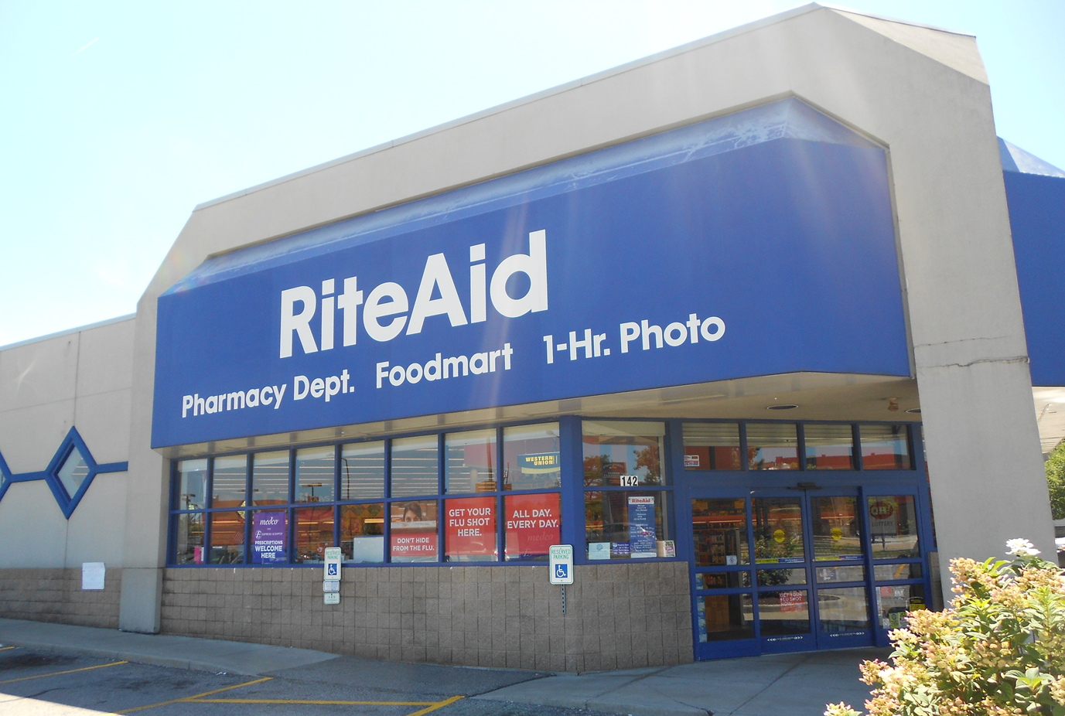



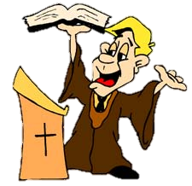
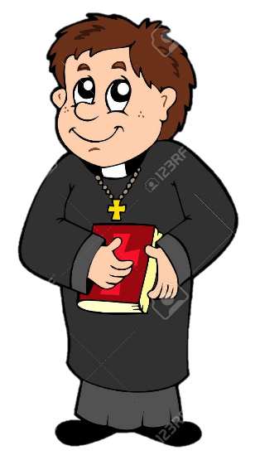


Many want to bring the “truth” out.
We need to take each other in!
The Word of God
The One and Only Truth Store
Be baptized!
The Word is the Truth, so let me take you inside.
There’s no Salvation outside of the Church!
God Loves Us!
Do you have the Holy Ghost?
Come be blessed!

Slide 79
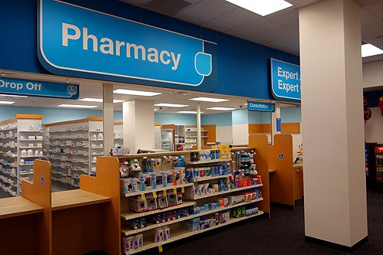
The Truth Sold Here
Search The Scriptures

Slide 80
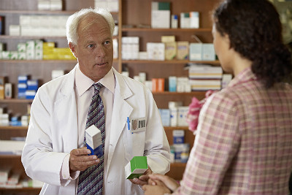
Jesus
TRUTH
*
TRUTH

Slide 81

God the Father
*
*
* The Holy Spirit is the life and the operator.

Slide 82
Psalms 118:8-9 It is better to trust in the LORD than to put confidence in man. 9 It is better to trust in the LORD than to put confidence in princes.
  Don’t believe me.
  Don’t believe the princes.
Romans 3:4 God forbid: yea, let God be true, but every man a liar; as it is written, That thou mightest be justified in thy sayings, and mightest overcome when thou art judged.
  Is there absolute truth? Absolutely.
  God owns it. Jesus sells it. The Word is where we get it.
  You need to get IN the word and seek for the truth as for hid treasure.
  You need to share it with your brethren and neighbors.

Slide 83
Stopped Here

Slide 84
Recap:
The truth is more valuable than anything you could desire.
God is looking for those that seek the truth as treasure.
We say that we want the truth, but we “can’t handle the truth”.
  The truth makes manifests, us to ourselves.
  You need to Buy the truth.
The price of truth may be extremely high:
  Money, Respect/Power, Energy/Work, Time, Family, All that you have
Selling the truth can net you great gain
  All the same, Possibly the whole world
Selling the truth will cost you your eternal life.
Buying the truth is an investment that will pay off ten-fold!
We all get a truth voucher. Are you going to sell yours or grow it and redeem it?
God is the owner of the truth. He hides it in Jesus.
We get the Truth in the Scripture, through Jesus, from God.
You can’t be partial, and bring truth out. You have to go in to the word of truth.

Slide 85
Questions/Answers on the Truth
What?
Why?
How?
Where?
When?
Who?

Slide 86
Acts 10:33 Immediately therefore I sent to thee; and thou hast well done that thou art come. Now therefore are we all here present before God, to hear all things that are commanded thee of God.
  Cornelius didn’t wait around to hear the truth.
  Immediately do what? Immediately believe?
Galatians 1:15-17 But when it pleased God, who separated me from my mother's womb, and called me by his grace, 16 To reveal his Son in me, that I might preach him among the heathen; immediately I conferred not with flesh and blood: 17 Neither went I up to Jerusalem to them which were apostles before me; but I went into Arabia, and returned again unto Damascus.
  As soon as God revealed the truth, immediately Paul chased it.
  He didn’t see what other’s thought, he just immediately went searching for the truth.

Slide 87
Proverbs 8:17 I love them that love me; and those that seek me early shall find me.
  You are to seek God and His truth early. Before you care for yourself, or your own.
Isaiah 55:6 Seek ye the LORD while he may be found, call ye upon him while he is near:
  He can be found when?
Jeremiah 25:4 And the LORD hath sent unto you all his servants the prophets, rising early and sending them; but ye have not hearkened, nor inclined your ear to hear.
  He comes near to you early. Not late. Maybe that’s why it is an inconvenient time.
Psalms 63:1 O God, thou art my God; early will I seek thee: my soul thirsteth for thee, my flesh longeth for thee in a dry and thirsty land, where no water is;
  He sends his truth to us early! We should seek after it early, immediately!
  We are in a land destitute of the truth. We’re dying of thirst for the truth. This world is a truth desert. Interesting that Paul went into the desert seeking the truth.
  But instead?

Slide 88
Luke 24:25 Then he said unto them, O fools, and slow of heart to believe all that the prophets have spoken:
  You shouldn’t be quick to believe what you hear from me.
  You SHOULD be quick to believe the Word of God.
  Don’t be slow to believe the prophets, the scripture.
  We are slow because there are so many lies in the world, right?
John 5:46-47 For had ye believed Moses, ye would have believed me: for he wrote of me. 47 But if ye believe not his writings, how shall ye believe my words?
  The book is how we know truth from lie. You have to be IN it.
  If you believed the rest of the Bible, nothing wouldn’t shock you, and you wouldn’t be SLOW to believe.
  You either a) don’t know what scripture says, or b) you choose not to believe what it says.
    The Jews wanted a king to conquer for them (partial truth), not a humble priest to shame them.
  Why so many denominations? Why so few with the truth?
  Many say they want the truth, and they go to church and believe in Jesus. But they don’t want the real truth. Not the hard truths. They want fellowship and love and motivation. They want convenient lies.

Slide 89
1 John 4:1 Beloved, believe not every spirit, but try the spirits whether they are of God: because many false prophets are gone out into the world.
  Don’t believe everything you hear. Receive what you hear (out of the Word), and find out whether it is truth, IN the Word.
  There are MANY false prophets, teachers, preachers.
Revelation 2:2 I know thy works, and thy labour, and thy patience, and how thou canst not bear them which are evil: and thou hast tried them which say they are apostles, and are not, and hast found them liars:
  How can you do this? How can you try spirits? How can you try apostles?

Slide 90
Psalms 105:19 Until the time that his word came: the word of the LORD tried him.
  The Word of God is what tries the truth, what tries men and angels.
  Well what are the “signs of an apostle”?
  Does any prophecy fail?
Acts 17:11 These were more noble than those in Thessalonica, in that they received the word with all readiness of mind, and searched the scriptures daily, whether those things were so.
  They didn’t believe everything the apostles said right away. But they did receive the Word. And immediately, early, daily, searched the word.
  They were buying the truth.
  Your mind should be ready for the rain, the food.
  That is what God considers noble. That is what he considers worthy.
  You need the truth EARLY. Seek it daily.
  But then what next? Then do what with it?

Slide 91
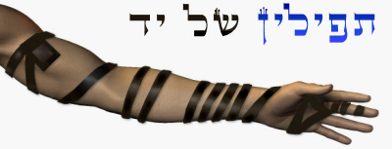
Deuteronomy 6:6-9 And these words, which I command thee this day, shall be in thine heart: 7 And thou shalt teach them diligently unto thy children, and shalt talk of them when thou sittest in thine house, and when thou walkest by the way, and when thou liest down, and when thou risest up. 8 And thou shalt bind them for a sign upon thine hand, and they shall be as frontlets between thine eyes. 9 And thou shalt write them upon the posts of thy house, and on thy gates.
  For you to see. For your house to see.
  Live in the truth. Dwell in it.
Proverbs 3:3 Let not mercy and truth forsake thee: bind them about thy neck; write them upon the table of thine heart:
  Wear the truth. Hide it in your heart.

Slide 92
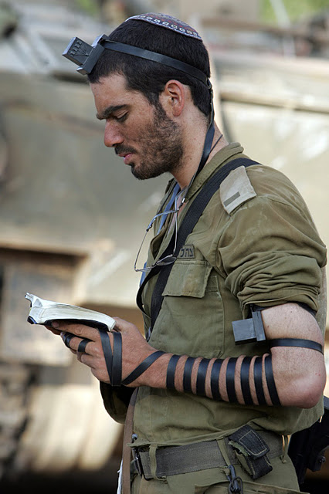
Phylacteries & Frontlets are supposed to be a sign, a reminder to YOU to keep God’s word.
“they make broad their phylacteries”

Slide 93
Acts 24:25 And as he reasoned of righteousness, temperance, and judgment to come, Felix trembled, and answered, Go thy way for this time; when I have a convenient season, I will call for thee.
  Most often, there is no convenient time to accept the truth.
  You need to receive it, and immediately, early, and daily, search for it.
  Then, when you’ve found it: BUY it, save it, wear it, and share it!

Slide 94
Questions/Answers on the Truth
What?
Why?
How?
Where?
When?
Who?

Slide 95
Who? You. YOU are to seek it, buy it, and share it with EVERYONE else.
You are expected to:
Believe the truth. (Buy it)
Seek the truth. (Buy it)
Share the truth. (Trade it)

Slide 96
You are expected to believe the truth
2 Thessalonians 2:13 But we are bound to give thanks alway to God for you, brethren beloved of the Lord, because God hath from the beginning chosen you to salvation through sanctification of the Spirit and belief of the truth:
  God chose you as one of his believers. You were CHOSEN by God to believe the truth!!
2 John 1:2 For the truth's sake, which dwelleth in us, and shall be with us for ever.
  How dare we say “this shall not be”, or “go thy way”.
Isaiah 66:2 For all those things hath mine hand made, and all those things have been, saith the LORD: but to this man will I look, even to him that is poor and of a contrite spirit, and trembleth at my word.
  You are supposed to tremble at his Word, his Truth.

Slide 97
Psalms 78:21-22 Therefore the LORD heard this, and was wroth: so a fire was kindled against Jacob, and anger also came up against Israel; 22 Because they believed not in God, and trusted not in his salvation:
Psalms 78:40 How oft did they provoke him in the wilderness, and grieve him in the desert!
  Rejecting his truth, his teachings, grieves him. Don’t provoke him.
  Don’t temp him to destroy you.
2 Timothy 3:7-8 Ever learning, and never able to come to the knowledge of the truth. 8 Now as Jannes and Jambres withstood Moses, so do these also resist the truth: men of corrupt minds, reprobate concerning the faith.
  Do not resist the truth. Accept it with a willing and ready mind.
  All readiness of mind. Whatever the truth may be, I am ready to accept it.
  Knowing that the Bible is our only source of assured, untainted, absolute, truth.
  You are expected to believe the truth.

Slide 98
You are expected to seek the truth
Proverbs 2:3-5 Yea, if thou criest after knowledge, and liftest up thy voice for understanding; 4 If thou seekest her as silver, and searchest for her as for hid treasures; 5 Then shalt thou understand the fear of the LORD, and find the knowledge of God.
  Thou.
  Where do you look?

Slide 99
2 Timothy 2:15 Study to shew thyself approved unto God, a workman that needeth not to be ashamed, rightly dividing the word of truth.
Matthew 13:12 For whosoever hath, to him shall be given, and he shall have more abundance: but whosoever hath not, from him shall be taken away even that he hath.
  The more truth you have, the more you can take, and the faster you will get it.
  Owen eats slow and small, I eat big and fast.
1 Corinthians 3:1-2 And I, brethren, could not speak unto you as unto spiritual, but as unto carnal, even as unto babes in Christ. 2 I have fed you with milk, and not with meat: for hitherto ye were not able to bear it, neither yet now are ye able.
  You have God’s truth. His will is for you to get more, to be rich in truth.
  …and to share it with all!

Slide 100
You are expected to share and teach the truth
Isaiah 38:19 The living, the living, he shall praise thee, as I do this day: the father to the children shall make known thy truth.
  You are to make known God’s truth.
2 Peter 3:9 The Lord is not slack concerning his promise, as some men count slackness; but is longsuffering to us-ward, not willing that any should perish, but that all should come to repentance.
  His will is for you to share the truth with all!

Slide 101
Romans 10:14-15 How then shall they call on him in whom they have not believed? and how shall they believe in him of whom they have not heard? and how shall they hear without a preacher? 15 And how shall they preach, except they be sent? as it is written, How beautiful are the feet of them that preach the gospel of peace, and bring glad tidings of good things!
  How can any come to repentance and belief of the truth if they aren’t warned.
  Well, this is God sending you. You are to be a teacher and preacher of the truth.
2 Timothy 4:1-2 I charge thee therefore before God, and the Lord Jesus Christ, who shall judge the quick and the dead at his appearing and his kingdom; 2 Preach the word; be instant in season, out of season; reprove, rebuke, exhort with all longsuffering and doctrine.
  You can’t say you don’t know what your job is, what God’s will for you is.
  Preach the truth.

Slide 102
Jeremiah 9:3 And they bend their tongues like their bow for lies: but they are not valiant for the truth upon the earth; for they proceed from evil to evil, and they know not me, saith the LORD.
  God wants you to be valiant for the truth. To prepare it, to aim it, to send it forth from your bow.
Proverbs 9:9-10 Give instruction to a wise man, and he will be yet wiser: teach a just man, and he will increase in learning. 10 The fear of the LORD is the beginning of wisdom: and the knowledge of the holy is understanding.
  The scorner will hate you. The wise man will love you.
  Your job is to give instruction. To give the truth.

Slide 103
Proverbs 23:23 Buy the truth, and sell it not; also wisdom, and instruction, and understanding.
3 John 1:4 I have no greater joy than to hear that my children walk in truth.
  It is expected of you to live and walk in the truth.
  To do it. To be truthful. To find it. Get rid of lies, sins that you have to hide and lie about.
  Seek the truth early. Plead for it.
  Sell all you have and buy it! Then share it.

Slide 104
Questions?

Slide 105
Back-up Stuff

